Slide 1
Efficient Reinforcement Learning with Hierarchies of Machines by Leveraging Internal Transitions
Aijun Bai* Stuart Russell
UC Berkeley/Microsoft Research UC Berkeley

Slide 2
Outline
Hierarchical RL with partial programs
Deterministic internal transitions
Results

Slide 3
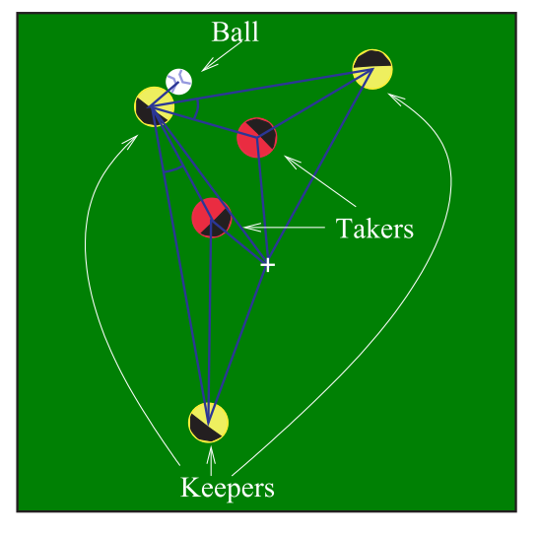
Hierarchical RL with partial programs
[Parr & Russell, NIPS 97; Andre & Russell, NIPS 00, AAAI 02; Marthi et al, IJCAI 05]
Partial program
a
Learning algorithm
s,r
Completion
Hierarchically optimal
for all terminating programs

Slide 4
Partial Program – an Example
repeat forever
Choose({a1,a2,…})

Slide 5
Partial Program – an Example
Navigate(destination)
while ¬At(destination,CurrentState())
Choose({N,S,E,W})

Slide 6
Concurrent Partial Programs
Top()
for each p in Effectors()
PlayKeep(p)
PlayKeep(p)
s ← CurrentState()
while ¬Terminal(s)
if BallKickable(s) then Choose({Pass(),Hold()})
else if FastestToBall(s) then Intercept()
else Choose(Stay(),Move())
Pass()
KickTo(Choose(Effectors()\{self}),Choose({slow,fast})
…

Slide 7
Technical development
Decisions based on internal state
Joint state ω = [s,m] environment state + program state (cf. [Russell & Wefald 1989] )
MDP + partial program = SMDP over choice states in {ω}, learn Q(ω,c) for choices c
Additive decomposition of value functions
by subroutine structure [Dietterich 00, Andre & Russell 02] Q is a sum of sub-Q functions per subroutine
across concurrent threads [Russell & Zimdars 03] Q is a sum of sub-Q functions per thread, with decomposed reward signal

Slide 8
Internal Transitions
Top()
for each p in Effectors()
PlayKeep(p)
PlayKeep(p)
s ← CurrentState()
while ¬Terminal(s)
if BallKickable(s) then Choose({Pass(),Hold()})
else if FastestToBall(s) then Intercept()
else Choose(Stay(),Move())
Pass()
KickTo(Choose(Effectors()\{self}),Choose({slow,fast})
…
Transitions between choice points with no physical action intervening
Internal transitions take no (real) time and have zero reward
Internal transitions are deterministic

Slide 9
Idea 1
Use internal transitions to shortcircuit the computations of Q values recursively if applicable
If (s, m, c) -> (s, m’) is an internal transition
Then, Q(s, m, c) = V(s, m’) = max_{c’} Q(s, m’, c’)
Cache internal transitions as <s, m, c, m’> tuples
No need for Q-learning on these

Slide 10
Idea 2
Identify weakest precondition P(s) for this internal transition to occur (cf EBL, chunking)
Cache internal transitions as <P, m, c, m’> tuples
Cache size independent of |S|, roughly proportional to size of partial program call graph

Slide 11
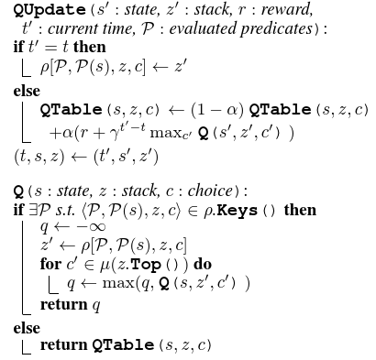
The HAMQ-INT Algorithm
Track the set of predicates since last choice point
Save an abstracted rule of internal transition if qualified (τ = 0) in a dictionary ρ
Use the saved rules to shortcircuit the computation of Q values recursively whenever possible
Notes:
(t, s, a) is a tuple of last update time, last env state and last call stack.

Slide 12
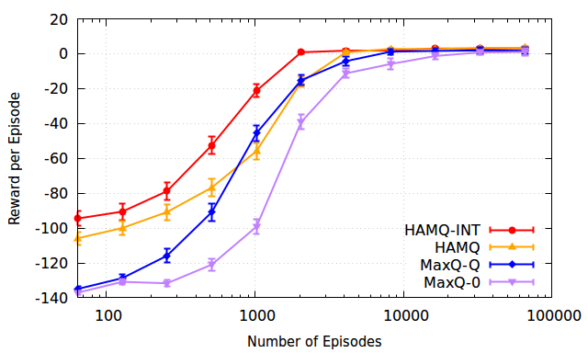
Experimental Result on Taxi

Slide 13
3 vs 2 Keepaway Comparisons
Option (Stone, 2005):
Each keeper learning separately
Learn a policy over Hold() and Pass(k, v) if ball kickable; otherwise, follow a fixed policy
Intercept() if fastest to the ball; otherwise, GetOpen()
GetOpen() is manually programmed for Option
Concurrent-Option:
Concurrent version of Option
One global Q function is learnt
Random: randomized version of Option
Concurrent-HAMQ
Learn its own version of GetOpen() by calling Stay() and Move(d, v)
Concurrent-HAMQ-INT

Slide 14
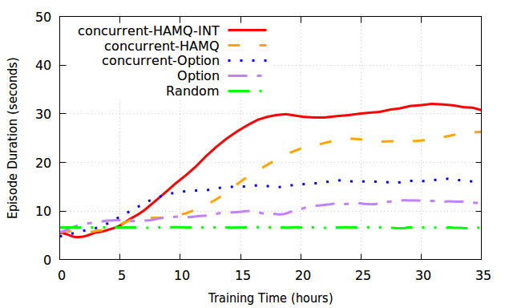
Experimental Result on Keepaway
Notes:
Training time as of the simulator time: one cycle corresponds to 100ms

Slide 15
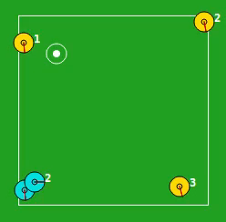
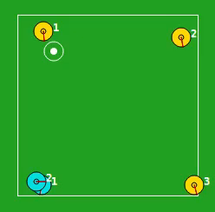
Before and After
Initial policy
Converged policy
Notes:
The vides can be played. Initial policy is guided by a random Q function. The policy its self is thus fixed.

Slide 16
Summary
HAMQ-INT algorithm
Automatically discovers internal transitions
Takes advantage of internal transitions for efficient learning
Outperforms the state of the art significantly on Taxi and RoboCup Keepaway
Future work
Scale up to full RoboCup task
More general integration of model-based and model-free reinforcement learning
More flexible forms of partial program (e.g., temporal logic)

